Slide 1

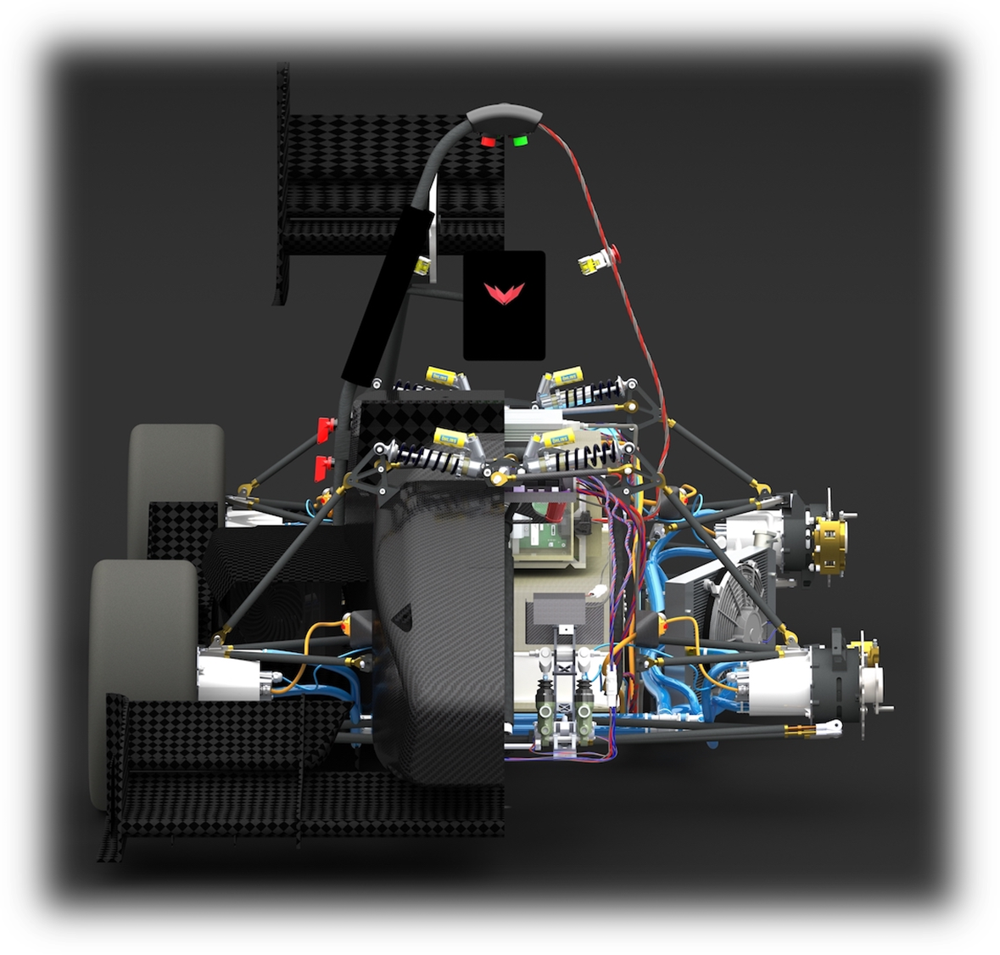
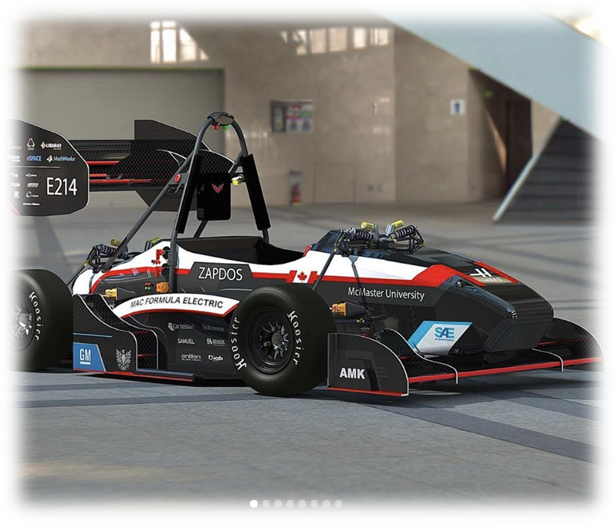
McMaster Formula Electric Vehicle Controls System
Team 28:
Controls Freaks
2023/03/25 MECHTRON 4TB6: Mechatronics Capstone Team 28:Controls Freaks

Slide 2





Team
Dharak Verma Comp Eng IV
Abhishek Magdum Mechatronics IV
Jason Surendran Mechatronics Mgmt. V
Derek Paylor
Mechatronics Mgmt. V
Laura Yang
Mechatronics Mgmt. V

Slide 3
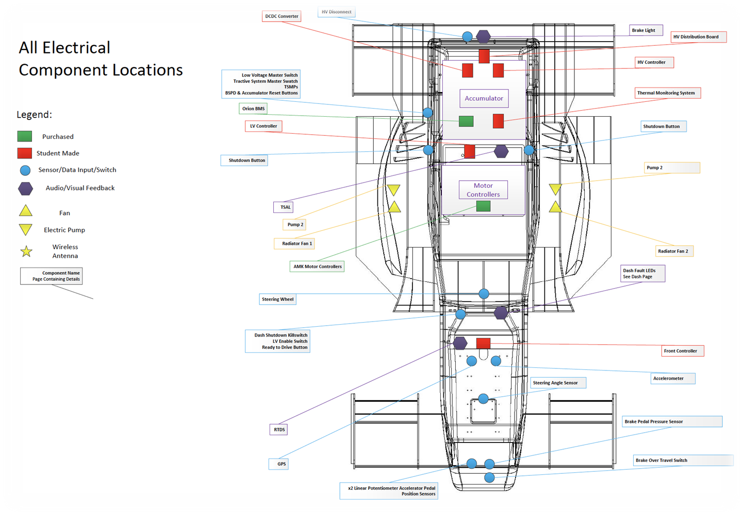
User and Context
McMaster Formula Electric
Vehicle’s mechanical & electrical systems designed, fabrication in process
Car needs embedded software to control the motor kit
AMK motor kit
CAN
Front Controller (STM32 MCU)
High-level objective
Within FSAE rules, determine motor commands based on driver input sensors, BMS CAN feedback, and motor kit CAN feedback - send commands to the motor over CAN
Goals
Modularity Maintainability | Support for SW simulation Hardware compatibility

Slide 4
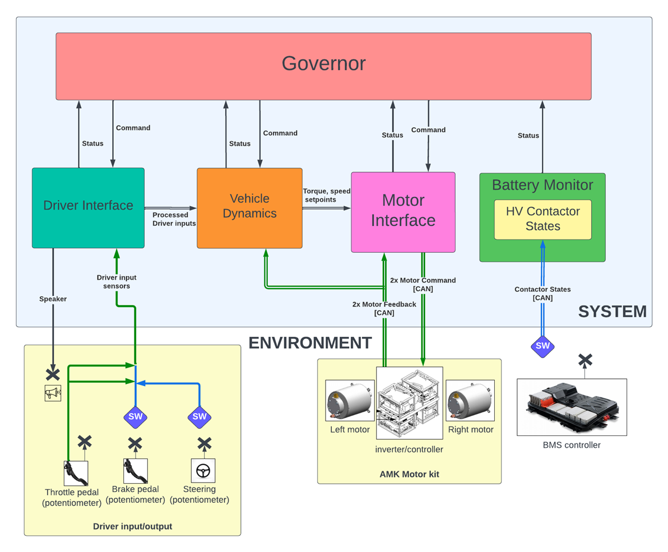
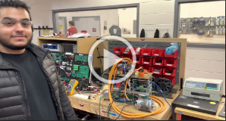
System and Environment
Notes:
Derek - talk about the diagram on the left - “system” comprises software modules/subsystems in our control system
Play the ~4 minute (?) run-through video of the hardware

Slide 5
System and Environment
Put video of dharak and derek doing walkthrough

Slide 6
Key Features
Model-based development
Model Testing environment
Hardware compatibility & integration stack
Benchtop testing at the model-level
Notes:
Briefly mention the 4 key features that add value to Mac FE

Slide 7
Key Features
Model-based development
modularity - easy to add/change logic, isolate from other modules
Stateflow
Simulation and data visualization (see P2)
add-ins (see below)
testing environment
test logic in SW without need for hardware
unit & system testing
entire block libraries that allow more sophisticated/realistic simulations
hardware compatibility / integration
auto-gen workflow (an example of simulink add-in)
already running on dev board (same STM chip)
benchtop CAN interfacing from laptop
another example of add-in
allows intermediary testing between full-SW sims and full-HW debugging

Slide 8
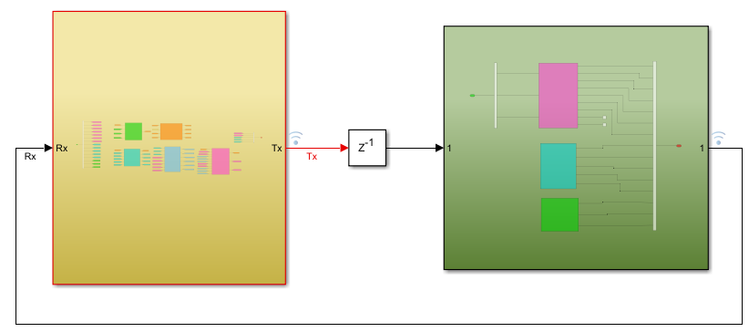
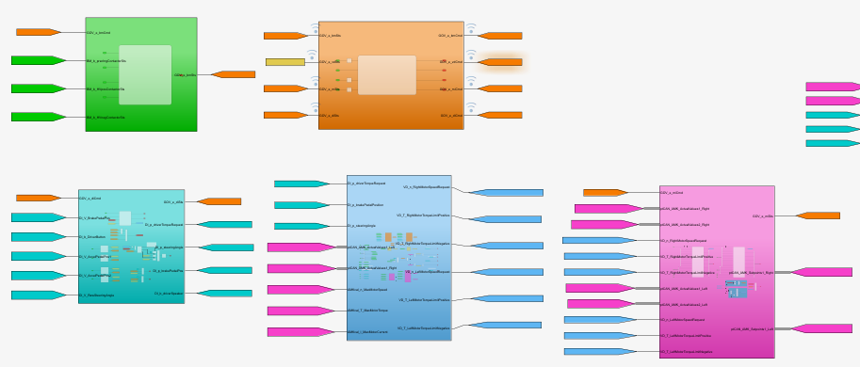
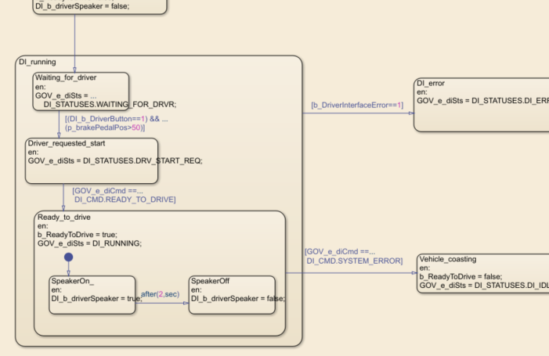
1. Model-based Development
Modularity
Each subsystem responsible for handling a specific vehicle function:
Driver Interface (DI)
Vehicle Dynamics (VD)
Motor Interface (MI)
Governor (Gov)
Battery Monitor (BM)
Hardware hiding
Eg. signal scaling, data type conversion, CAN interfacing occurs independently of the control system
Handled separately by the Plant model
Stateflow
Unmatched implementation and visualization of state machines
Used in MI, DI, BM and Gov
Notes:
Modularity - high level description of each module. Reinforce (1) clearly defined IO; (2) encapsulation - implementation change can be made within an individual subsystem, independently from the other subsystems
Hardware hiding - all the control system modules are encapsulated in the “controller” (yellow), sends signals to the “plant” (green) which contains signal scaling, data type conversions and CAN/GPIO interfacing for system IO
Stateflow -

Slide 9
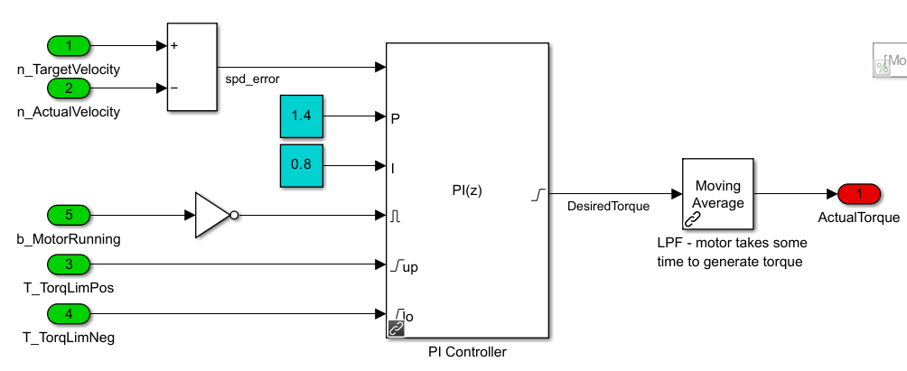
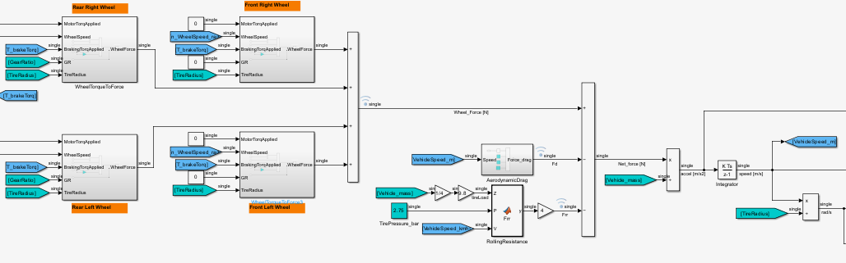
2. Model Testing Environment
System testing
Plant model
Simulates vehicle’s dynamic response to controller commands
Driver input signals are custom defined
Motor and vehicle response (torque, acceleration, speed) simulated using a physics-based model
Controller
Entire vehicle control system model
Notes:
The system testing environment reflects the classic control-plant feedback loop. The “Controller” (yellow) encapsulates the entire control system as described previously. The plant (green) takes place of the vehicle - taking controller commands, and simulating the vehicle’s dynamic responses, such as motor torque, vehicle speed & acceleration. Driver input signals (eg. pedals, button) are custom-defined signals, based on the test scenario (demonstration to follow)

Slide 10
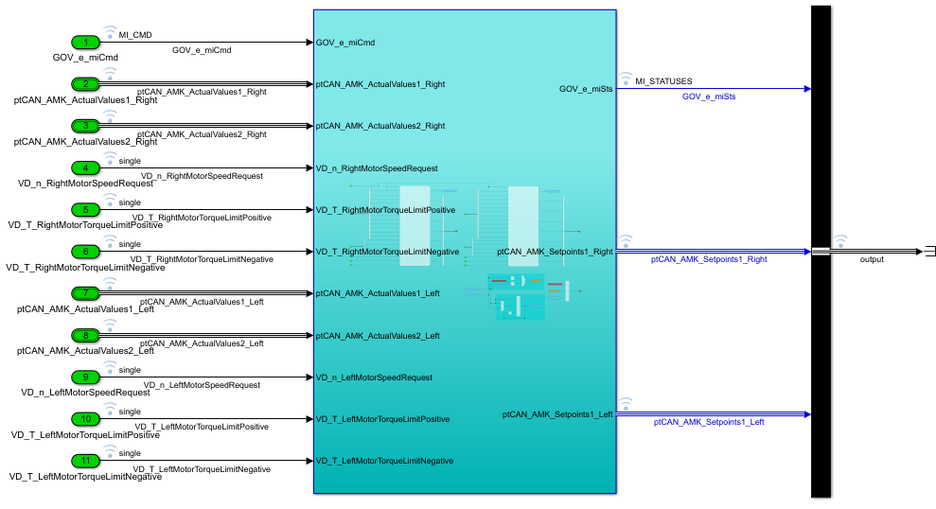
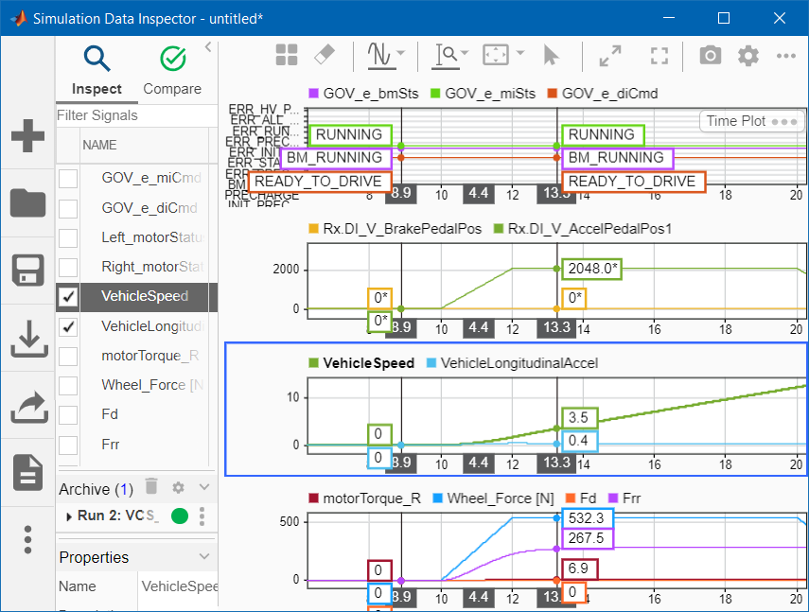
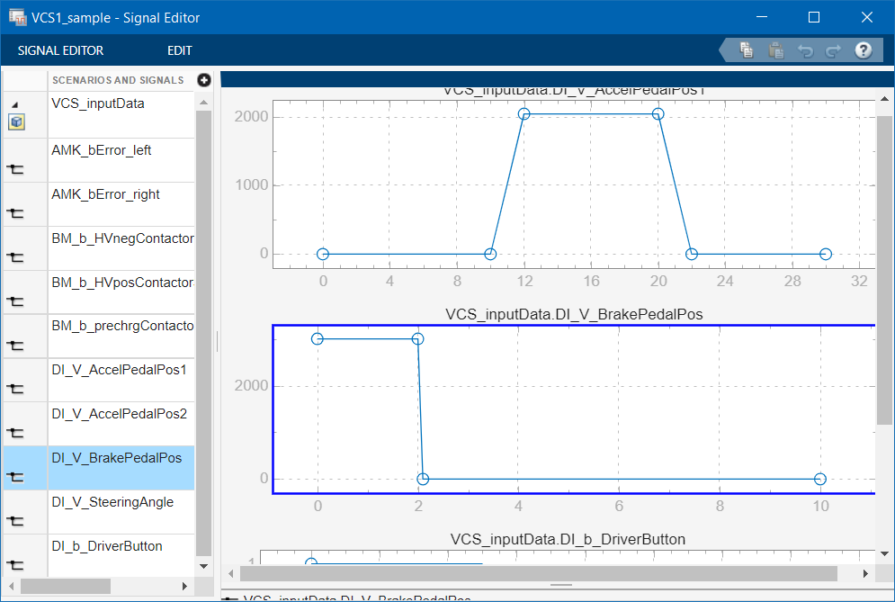
2. Model Testing Environment
Unit testing
Outputs logged for inspection
Inputs custom-defined based on test case

Slide 11
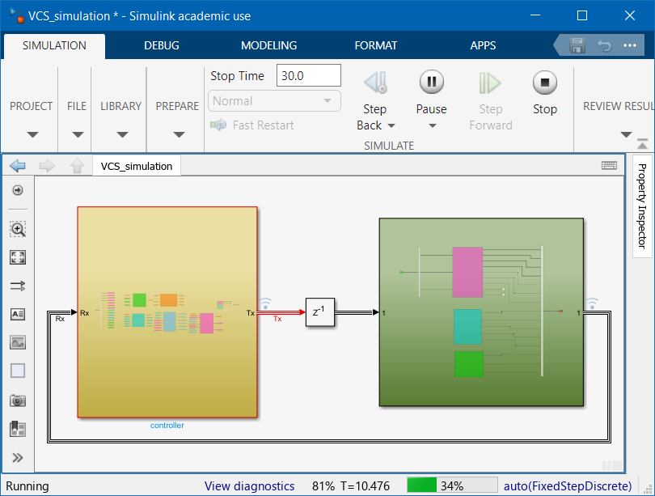
2. Model Testing Environment
Workflow
1. Build dynamic signal inputs using SignalEditor tool
Trace test scenarios to SRS
Store test scenario data to allow quick & consistent testing across new SW versions
2. Import data, run simulation
Load test case data from .mat file (system test); use root inport mapper (unit test)
3. Analyze logged output data using Simulink Data Inspector
Oscilloscope-like viewing of timeseries signals
Notes:
Demonstrate the startup & acceleration sim Again emphasize the ability to catch control logic errors before reaching HW

Slide 12
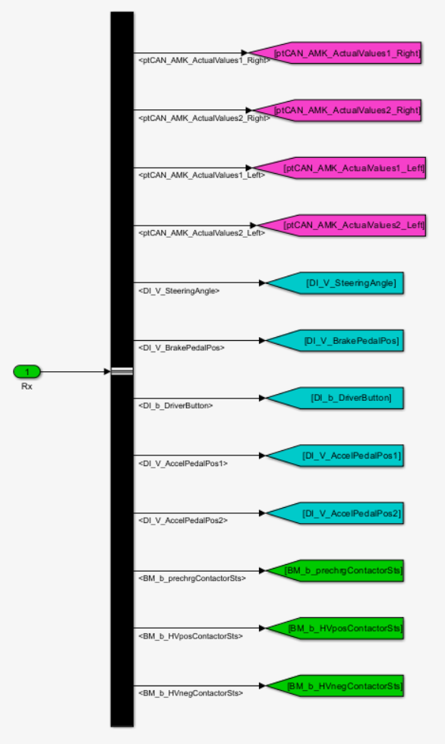
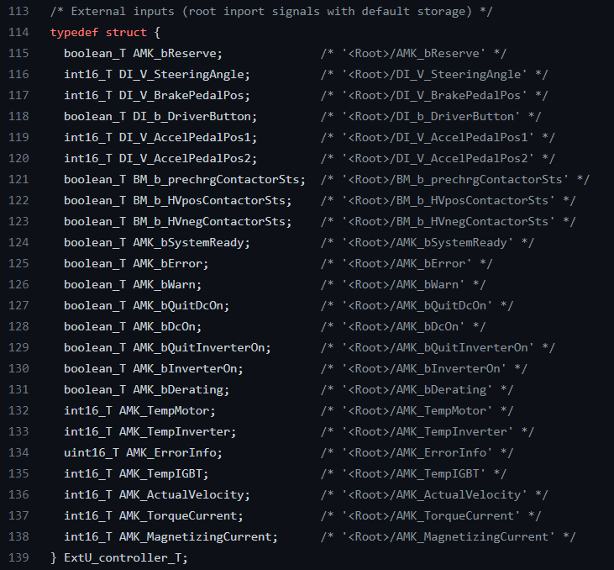
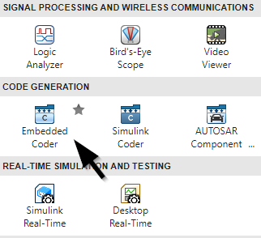
3. Hardware Compatibility & Integration
Code Generation
Embedded Coder Tool
C Inputs
Simulink Model Inputs
Notes:
Embedded coder tool used within simulink to generate C code that can be deployed to any embedded system
It creates C code for the entire model, as well as input and output structs to interface with it

Slide 13
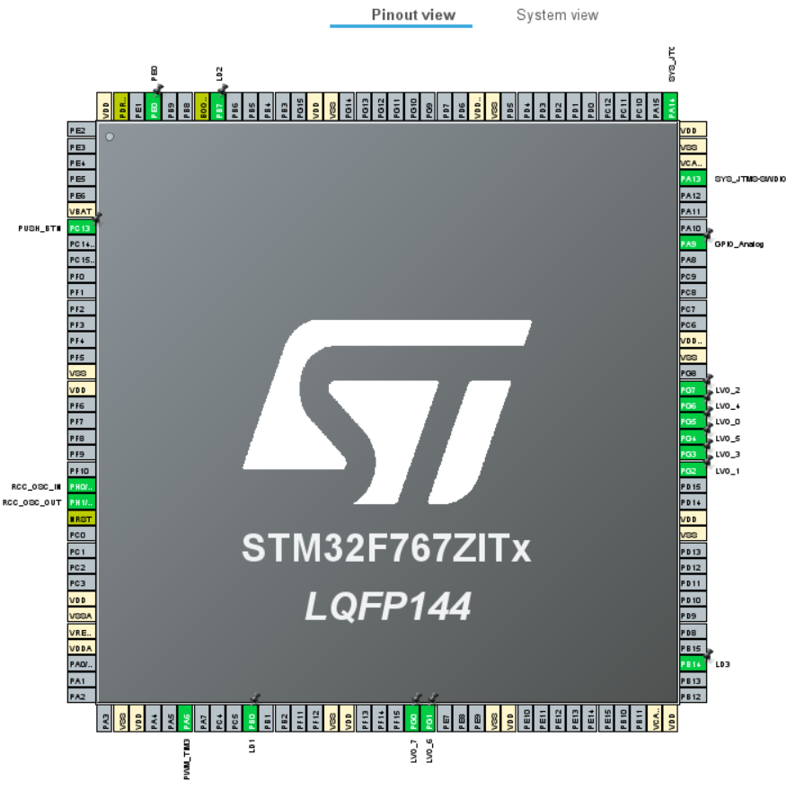
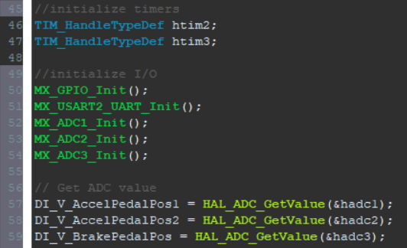
3. Hardware Compatibility & Integration
Code Integration
1. Map I/O in CubeIDE
SPI, ADC, CAN, etc.
Tie STM I/O to Simulink I/O
Notes:
To integrate the code, we map all of the STM I/O that our model uses, within the CubeIDE (SPI, ADC, CAN, Timers, etc.)
We tie the STM I/O to the model I/O

Slide 14
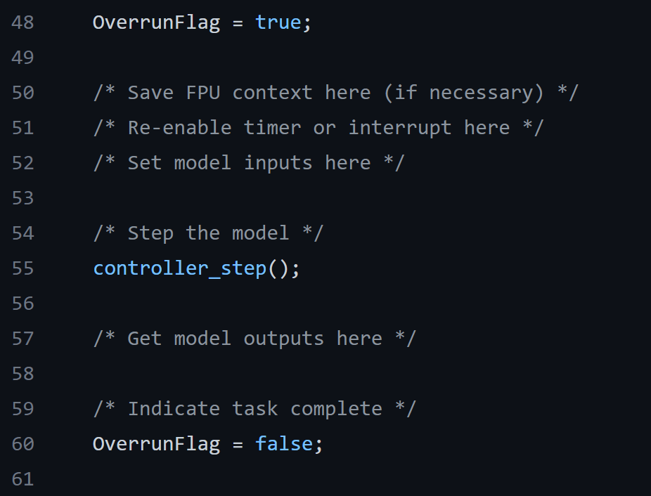
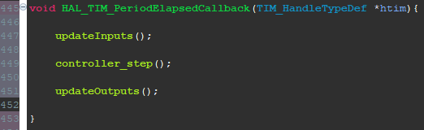
3. Hardware Compatibility & Integration
Code Runtime
Interrupt Function
Model Step Function
Notes:
To run model, auto generated code has function to take all inputs and produce an output
Simulink asks us to set model inputs, run the model, and then obtain the outputs
We do this inside of a timer interrupt on the STM board

Slide 15
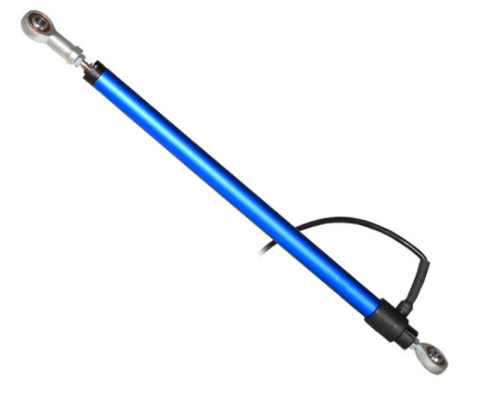
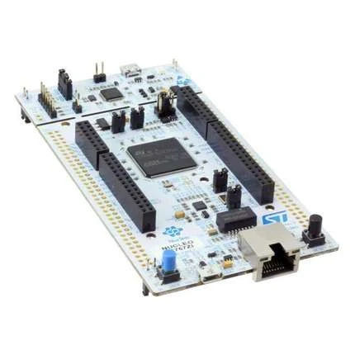
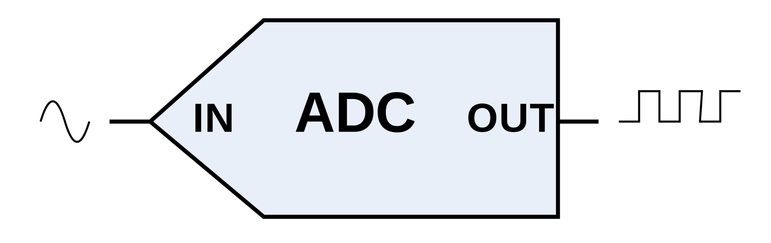
4. Benchtop Testing
Testing Flow
Linear Potentiometer
STM Development Board
Analog to Digital Conversion

Slide 16

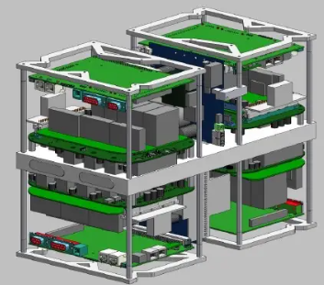
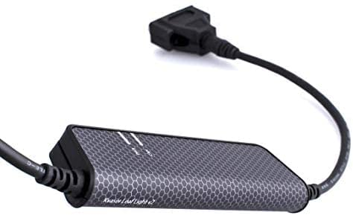
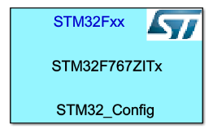
4. Benchtop Testing
Testing Flow
CAN Dongle
AMK Inverters
Control System on Host Laptop

Slide 17

4. Benchtop CAN Interfacing from Laptop

Slide 18
4. Benchtop Testing
Results
Modularity
Intermediate testing between SW and HW
Model driven via Simulink vs. ECU
Embedded code stack can slowly replace test hardware
CAN dongle -> CAN Stack
Redundancy
Software simulations for redundancy checks
Single out points of failure
Test each hardware component individually
Validate new software revisions via test setup
Limit number of variables

Slide 19
Future Additions
Driver Interface - one-pedal driving (regenerative braking)
Dynamically re-maps the throttle pedal to request varying degrees of both positive and negative torque
Vehicle Dynamics - Stability Control; Torque Vectoring
Apply positive/negative torque (braking/motoring) to specific wheels to aid cornering or stabilize the vehicle, based on accelerometers and driver inputs
Over the air data acquisition:
Log control system signal data to onboard memory; wirelessly transmit the data once the vehicle returns from a drive test
Gain vital vehicle data for control system calibration, and system modeling

Slide 20
Key Features
Model-based development
Modularity, hardware hiding
Stateflow
Simulation, data visualization
Add-ins
Model Testing environment
Test logic in SW without need for hardware
Unit & system testing
Block library packages for plant modeling
Hardware compatibility & integration stack
C code auto-gen (add-in)
Deployed to STM32 board, merged with CAN drivers (rev0)
Benchtop testing at the model-level
Hardware support package for STM (add-in)
Intermediary testing between SW sims and HW debugging
Notes:
Briefly mention the 4 key features that add value to Mac FE

